Slide 1

ACDI/VOCA Collector; aka DB Buddy
Notes:
In this presentation, we introduce DB Buddy, a bridge that extends the awesome power of ODK to cloud database MERL systems

Slide 2
DB Buddy Overview
Opportunity: Organizations striving for data-driven results and learnings fail because their data collection instruments undermine M&E data integrity
Market: Any organization doing M&E
Solution: Data collection instruments created by the underlying database instead of by hand, preserving data integrity
Key Stakeholders: M&E practitioners, donors, program design teams
Financial Impact: Results are measurable, reliable, and based on raw data returning true value to donor dollars
Social Impact: Data driven analysis generates new insights improving quality of program design
Team: M&E, IT, Data Science

Slide 3
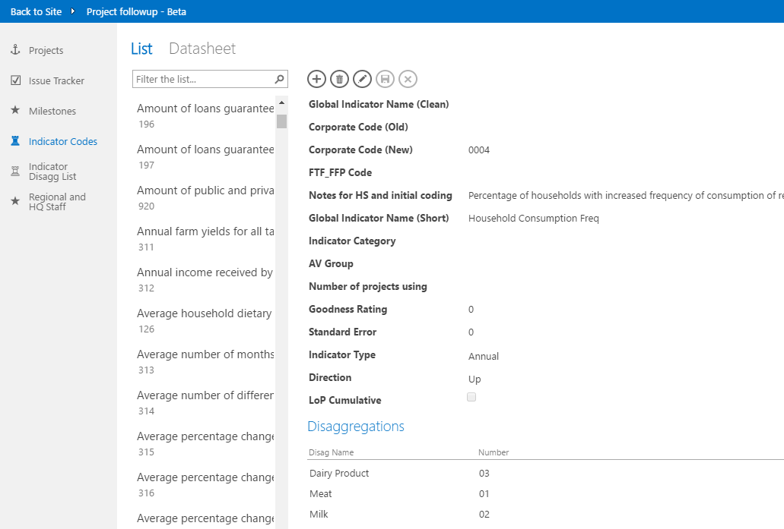
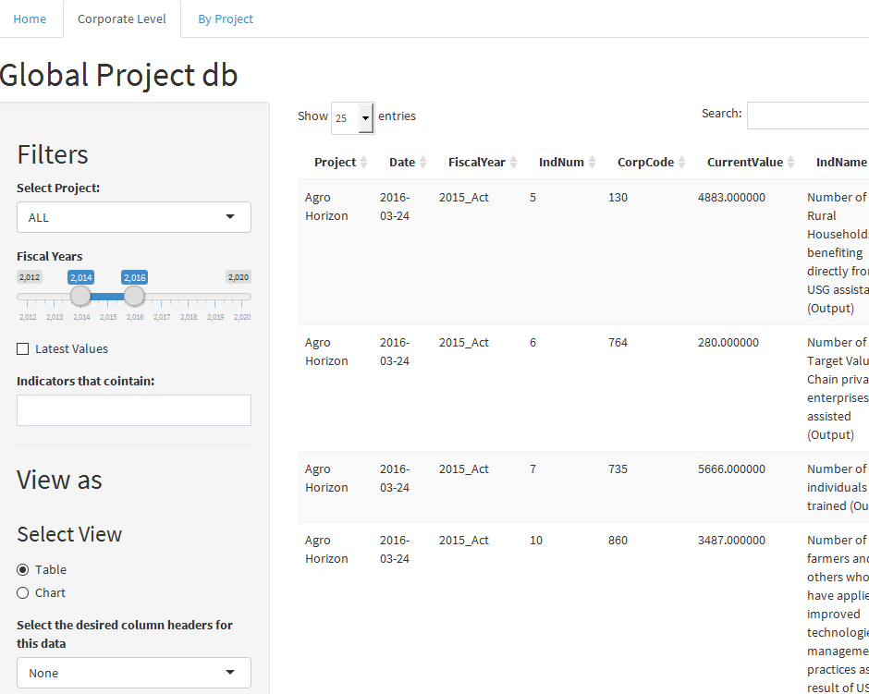

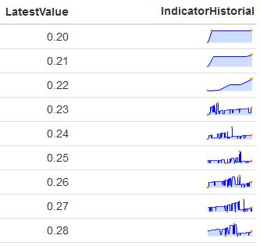
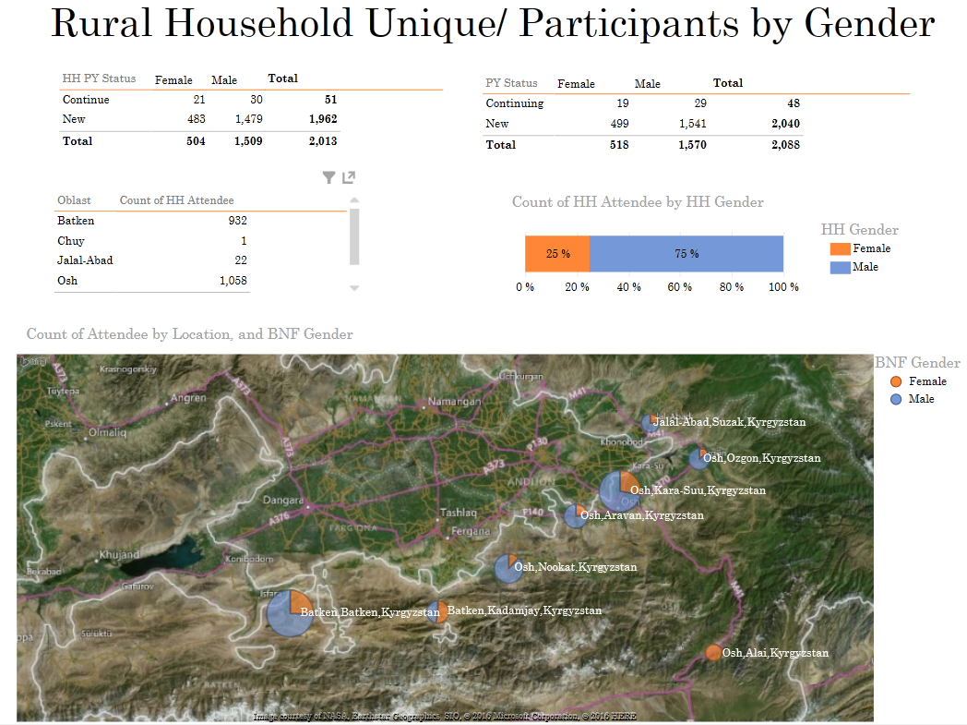
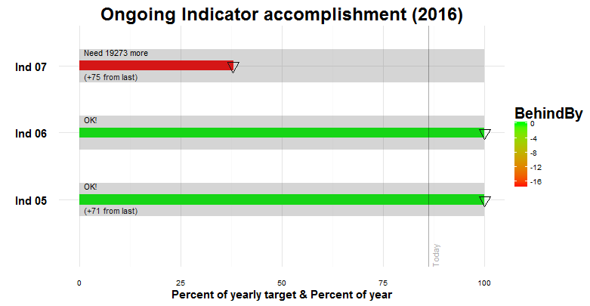
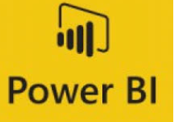

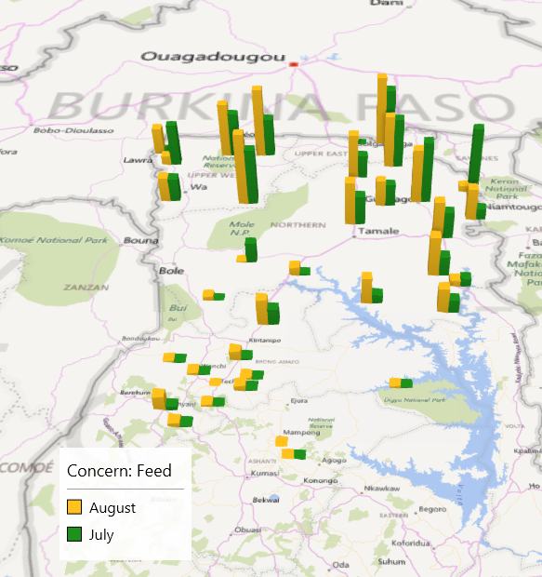
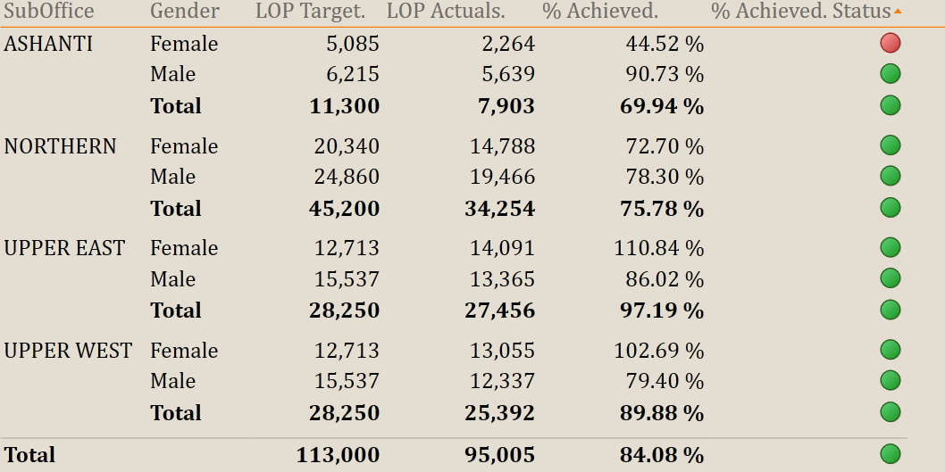
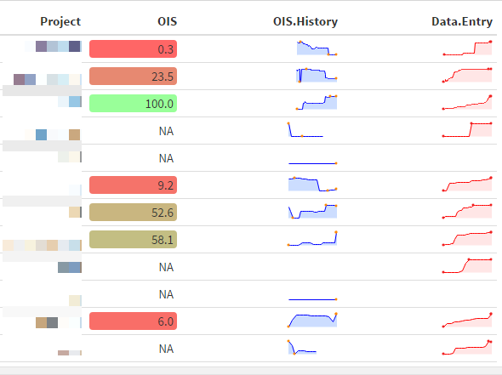
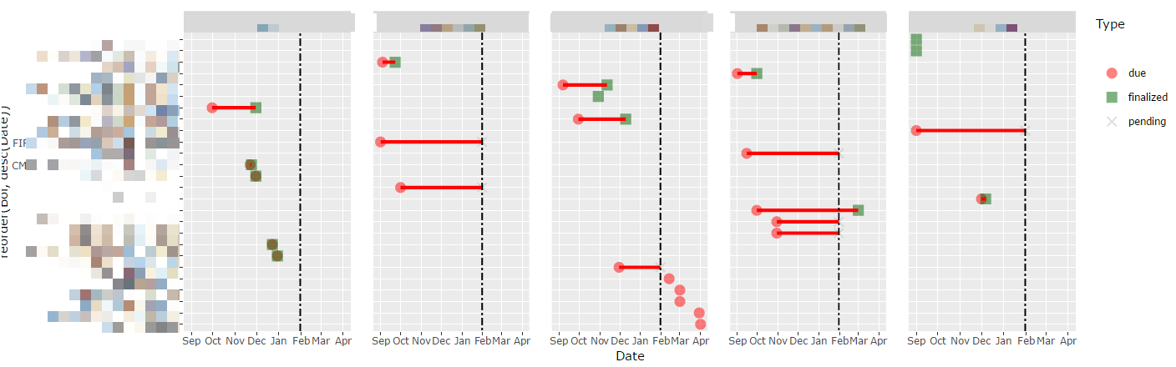
FULL
DETAILS
FAST &
EASY
RESPONSIBLE: PROJECT STAFF
(manual)
checks
RESPONSIBLE: REGIONAL STAFF
(automated)
Notes:
What do you want from your Monitoring and Evaluation platform?
You want data. You want details. Hard facts.
You want to be able to drill down from your indicators to raw beneficiary data. You want to pass data audits conducted by your donor.

Slide 4
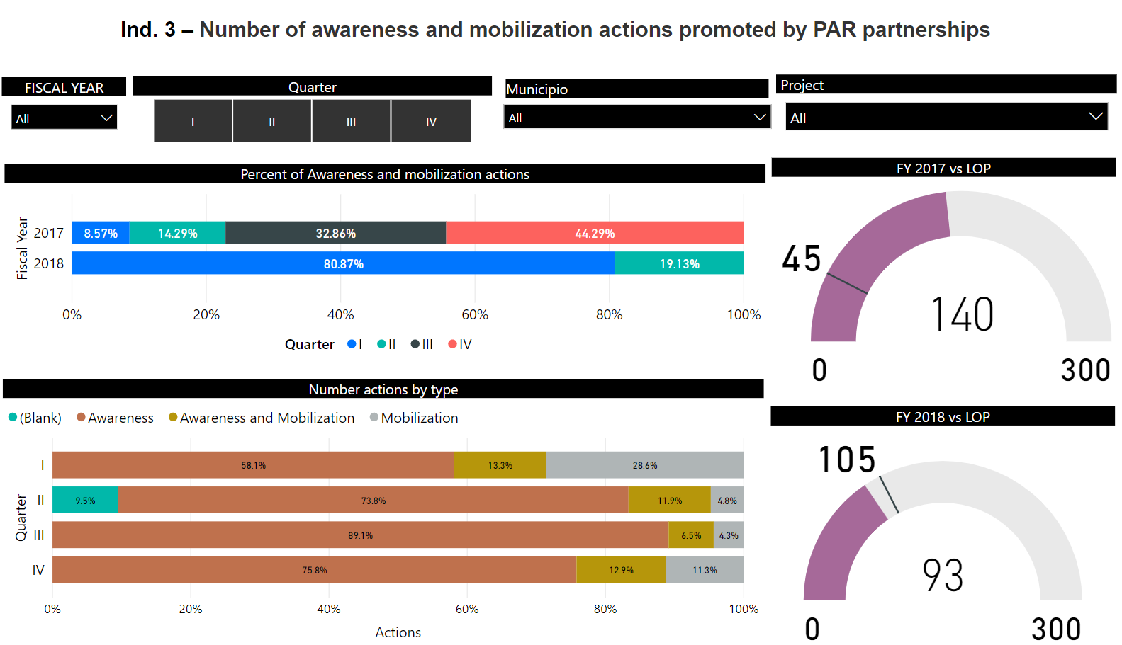
Notes:
You want to learn from data.
You want to use the field context to finetune your implementation. You want to do adaptive management

Slide 5
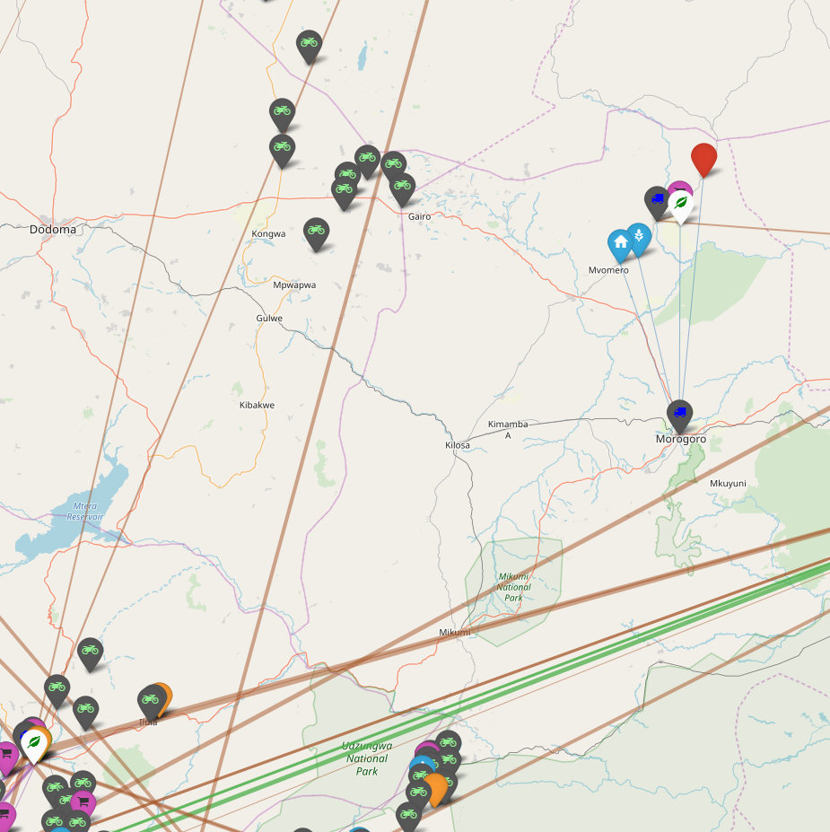
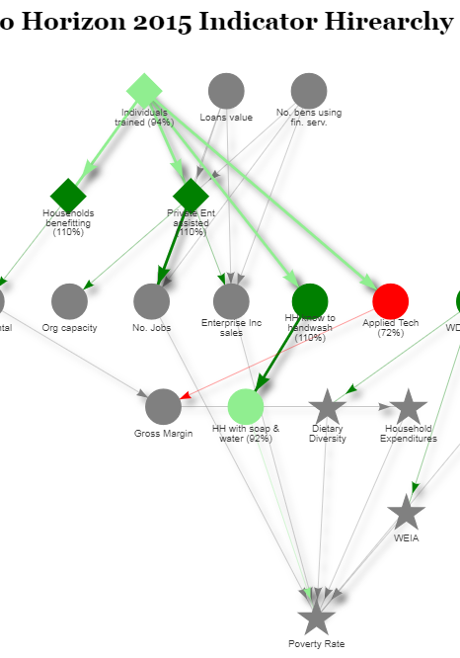
Notes:
You want to discover correlations between previously unrelated variables.
You want to be able to come to the donor with ideas about program design based on your field experience and learnings.
But for it to mean anything, your definitions have to be consistent, all your data fields valid. It has to stand up to rigorous examination.
You want data integrity.
But how do you get it?

Slide 6
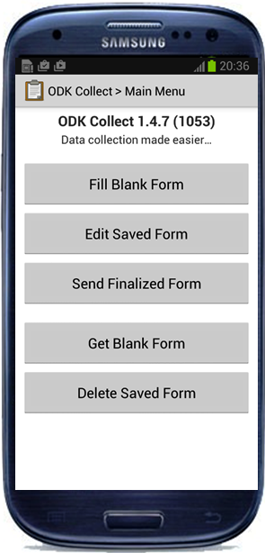
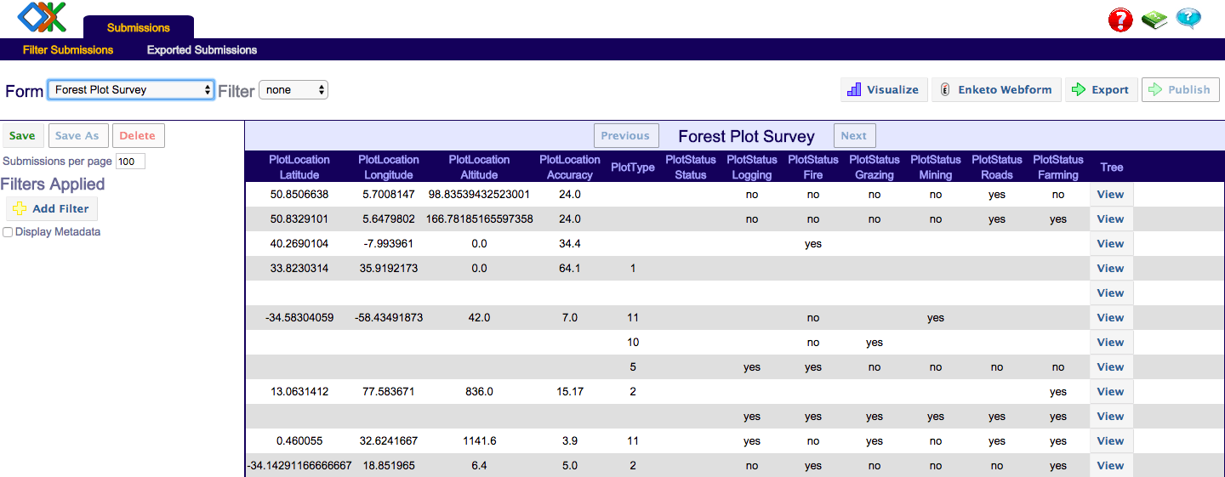
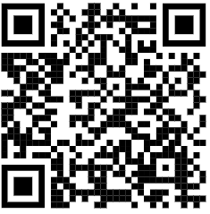
Monitoring and Evaluation Surveys
?
ACDI VOCA BLOG: Why You Should Be Using Raw, Relational Data
bit.ly/relational_data
Notes:
You do M&E Surveys! You do electronic data collection. If you’re not doing electronic data collection, this is not for you. But if you are, you know about surveys, how to create them, and how to use them.
You’re probably using ODK – Open Data Kit – or something like it to prepare your survey instruments for collection.
Many practitioners create their ODK forms from survey questions and use ODK Aggregate to store & visualize the results. This is a great start, but what happens when you want to compare these survey results against the results of another survey? Sure, it’s possible, but it’s a manual process and you need a really excellent data manager. And even then, the analysis will be ad hoc, irreproduceable, time-consuming and prone to errors.
To be clear, this is MUCH better than a system that only stores aggregate values, but it isn’t as good as having a relational system. We actually go over several storage options in our data blog, please follow the provided link or scan the QR code provided.
So ok what if we DO have a relational database?

Slide 7



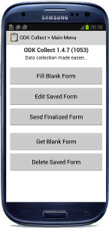

Monitoring and Evaluation Surveys, in a Cloud context
XLSForm
+
?
COLLECTOR
Notes:
OK, so now you have a wonderful cloud database with online backups, one-version-of-the-truth, multiple users entering data and all the other benefits, but what if you need to gather data from an area without a good internet connection? You COULD create an ODK form that matches the db, gather the data and then upload the results to the database, but there’s a few problems with that.
- Main problem is that the database can have multiple “Ana Gomez” or “Springfield” cities, making it difficult or impossible to assign data at the correct level
- It's very tricky to keep validations, default values, etc syncronized
- Sometimes people would create the ODK form without thinking about the database, which could be a problem in that not all concepts translate cleanly to relational databases (think multiple-selects, repeats, etc).
- Maybe we do the same survey the following year, but changed the schema of the database and then it's annoying to change the ODK schema to match the new schema (and then don't get around to uploading them).
- Since I can get an excel out of ODK... I don't see the value in uploading my precious impact data to the database... which of course means that we can't use it to do some deep impact analysis or data science.
- Sometimes feedback gets lost between different versions of the excel file, difficult/time-consuming to recover.
A data driven organization should find a way to eliminate the possibility of collecting invalid or duplicate data during these important survey efforts, so there’s 3 things we can do to collect offline data: hire someone to create our own app, hire someone to build a formal bridge, or invent our own!
That’s where DB Buddy comes in.

Slide 8
DB Buddy turns that collection model on its head.
Notes:
In DB Buddy, we start from the db, and provide a way for an authorized person to create a data collection form from any table in the db.
We use Googlesheet as a (transparent intermediary) and google drive as a way to synchronize the files.
The enumerators can collect their data the normal way, and when they are back in the hotel or within reach of the internet, they can simply push the data back online just as they would normally.
With DB Buddy ALL survey design is done on the cloud database itself!!
An authorized user user sends an email contains specific metadata to an email address that's monitored by Microsoft Flow. A script checks to see if that user is authorized, and if so, then uses the rest of the metadata in the email to start processing a table from a database based on the request.
The procedure creates an Excel spreadsheet that follows the protocol of xlsform (translating all the good metadata and lookups from the database)
Create an .xml form from this google sheet
Share permissions to both the sheet and the form based on a permissions table also managed by us
Presto! People have an ODK form that they can use to gather data!
(there is another script that is monitoring the results sheet of every database and will load any new data to the database)

Slide 9





DB Buddy technology/tool stack
Our
cloud
db
Universal
data
connector
Trigger to
start doing
stuff
Our VM
listening
to requests
The ETL
workhorse
❤❤❤
To automate
XML form
creation
Offline
data
collector
Notes:
This is our M&E technology stack. Yours doesn’t have to match this, but it should have the following features:
Data driven survey design
Electronic data collection via tablet or laptop
Data validation/cleansing platform
Relational backend
Data visualization layer

Slide 10

Live demo of DB Buddy

Slide 11
We envision a world in which people are
empowered to succeed in the global economy.
www.acdivoca.org

